Slide 1
F1 Analysis and regression
By Junyu Teoh

Slide 2
Introduction
- What is Formula-1(F-1)?
Highest class of single-seater auto racing
10 teams (constructors) with 2 drivers each
Two 90 minute practice sessions
Three 18 minute elimination qualifying
Race!
- Why F1?
F1 is HUGE!
Personal interest
Notes:
Bottom 5 drivers are elimited every round in quali
Quali determines your starting position

Slide 3
Differences between F1 and other popular motorsports
Nascar:
Nascars have more body panels that allow the drivers to bump into each other more often without significant damage
F1 cars are much more aerodynamic reliant than Nascars
World Rally Championship (WRC)
WRC cars have to race on many different types of surfaces and weather
F1 cars only race on proper tracks or street circuits, and will pause or cancel the race due to bad weather

Slide 4
Data analysis & Visualization

Slide 5
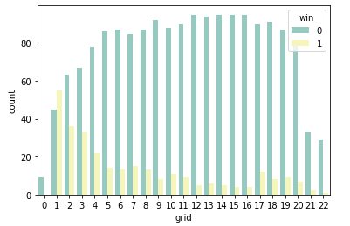
Starting position vs end position
Distribution of end position given a starting position
Highly recommended to start upfront
Drivers who start at a higher position (low value) get more wins
Notes:
Countplots! Shows count of observations in each categorical bin

Slide 6
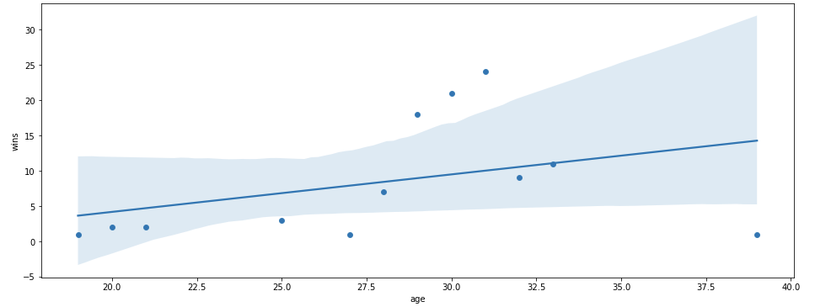
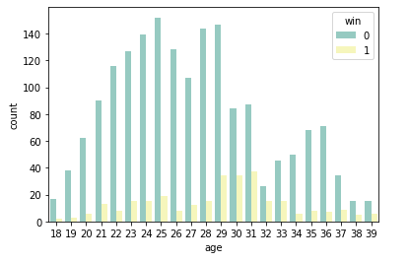
Age vs Wins
Wins are concentrated at around age 29-31
However, it seems to taper off quickly
Suggests driver only has a limited window to perform at their peak
Suggests that teams should choose a younger driver and develop them

Slide 7
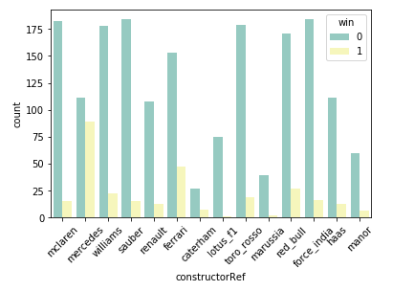
Wins vs Teams
Wins between 2014-2018 are largely by Mercedes, followed by Ferrari and Red Bull.

Slide 8
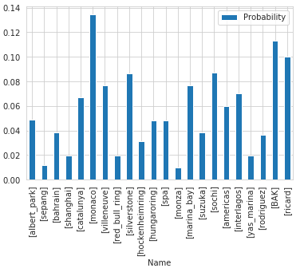
Probability of accident on Track
Street circuits such as Monaco and Baku top the charts at roughly 13.8% and 11.5% probability of an accident respectively.
Tracks designed with overtaking and spectator in mind like Sepang and Shanghai feature much smaller probability

Slide 9
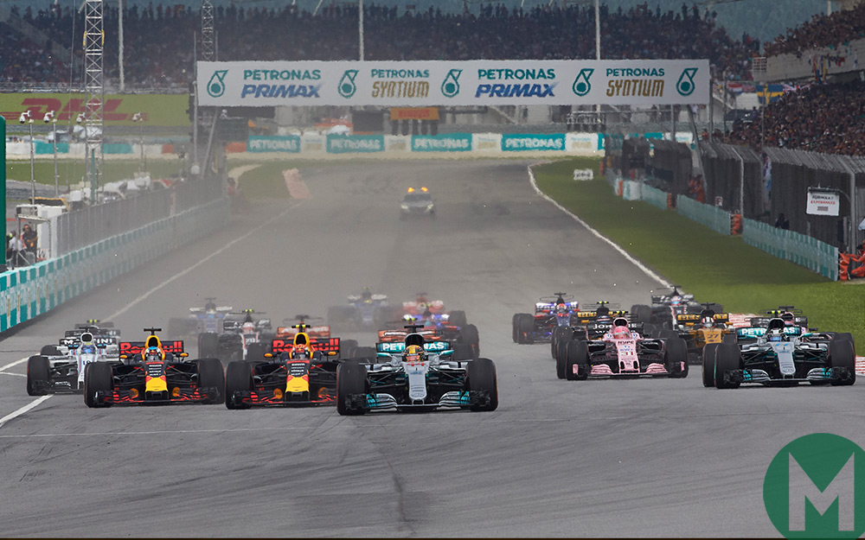
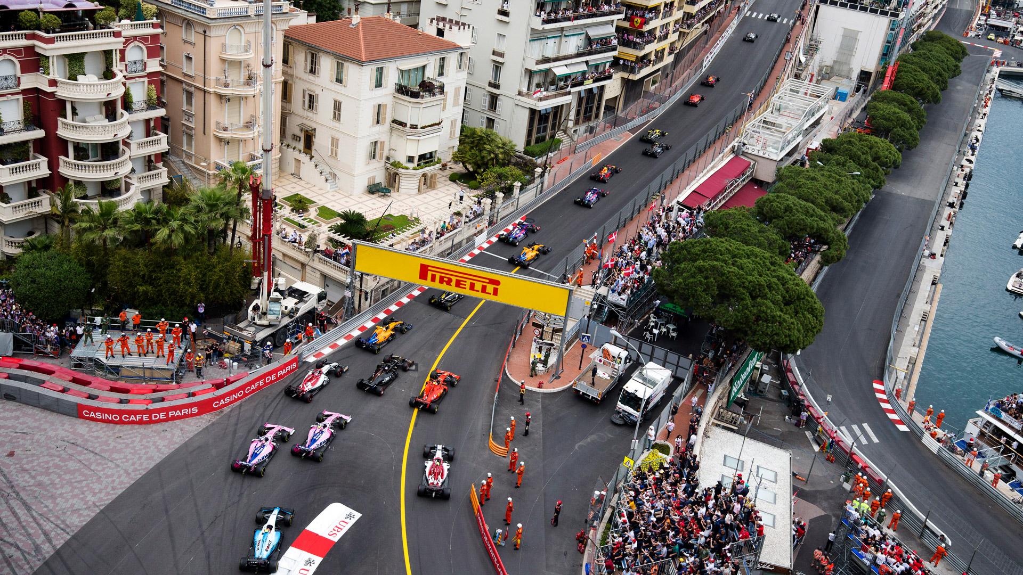
Probability of accident on Track
Top: Sepang international Circuit, Malaysia. It’s roughly 20 meters at it’s widest and 16 meters at it’s narrowest.
Bottom: Monaco Street Circuit. Only about 12 meters at it’s widest.
Even at it’s narrowest point, Sepang is till wider than Monaco.

Slide 10
Regression

Slide 11
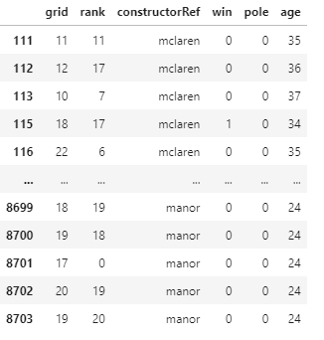
Data preparation
Multiple tables joined using Pandas
Null values replaced with 0
Unneeded columns were dropped to save memory

Slide 12
Linear Regression
ŷ= b0 + b1x1 + b2x2 + … + bnxn
Only outputs continuous variables
Outputs might not make sense at extreme ends

Slide 13
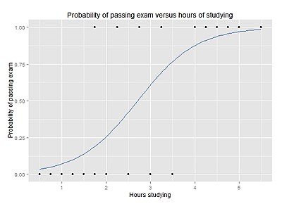
Logistic Regression
Logistic regression models the probability of a certain class existing
Outputs binary values
Extreme input values will still produce output within [0,1]

Slide 14
Model
Ln(Y/(1-Y)) = b0 + b1[grid] + b2[rank] + b3[age] + b4[pole]+b5[constructorRef] + error
Ln(Y/(1-Y)) = Logarithmic probability of categorization (categorical)
Grid = race start position (discrete numerical)
Rank = Rank of the fastest lap (discrete numerical)
Age = Age of driver during the race (discrete numerical)
ConstructorRef = Text representation of team name (categorical)
Pole = If driver achieved pole position during qualifying (starting from 1st place) (categorical)

Slide 15
Model
Ln(Y/(1-Y)) = b0 + b1[grid] + b2[rank] + b3[age] + b4[pole]+b5[constructorRef] + error
constructorRef dummified:
x1 = haas, x2 = sauber, x3 = Williams, x4 = caterham, x5 = Ferrari, x6 = lotus_f1, x7=toro_rosso, x8=Renault, x9= Mercedes, x10=mclaren, x11 = force_india, x12 = Marussia, x13 = red_bull or manor

Slide 16
Model evaluation
Precision measures how many selected items are relevant. Can be interpreted as measure of quality.
Recall measures how many relevant items are selected. Can be interpreted as measure of quantity.
 | Precision | recall | f1-score | support
0 | 0.87 | 0.99 | 0.93 | 1262
1 | 0.7 | 0.15 | 0.24 | 216
Accuracy |  |  | 0.87 | 1478
Macro avg | 0.78 | 0.57 | 0.59 | 1478
Weighted avg | 0.85 | 0.87 | 0.83 | 1478
High precision for class 0 suggests that the model can accurately predict the classification of 0. Further, having high recall also means that most of the relevant items were selected.
High precision for class 1 suggests that the model can accurately predict the classification of 1. However, having low recall means a small amount of the relevant items were selected. This can lead to high type-ii (False negative) errors.
Notice that the f-value for category 0 is much higher than category 1, suggesting that the model is much more accurate at classifying 0’s than 1’s.

Slide 17
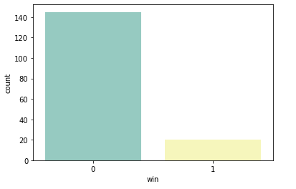
Model evaluation
 | Precision | recall | f1-score | support
0 | 0.87 | 0.99 | 0.93 | 1262
1 | 0.7 | 0.15 | 0.24 | 216
Accuracy |  |  | 0.87 | 1478
Macro avg | 0.78 | 0.57 | 0.59 | 1478
Weighted avg | 0.85 | 0.87 | 0.83 | 1478
Low recall for category 1 suggests that the model has a hard time correctly identifying the relevant entries within the dataset
High precision for category 1 suggests that the model is pretty good at identifying the relevant data points.
This imbalance is probably due to the highly skewed input data

Slide 18
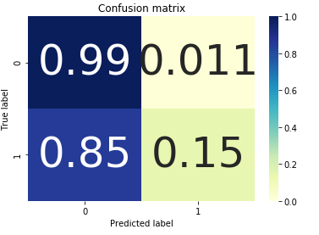
Model Evaluation
High probability of true negative means high probability of classifying a driver as a loser, and being right.
Low probability of false positive means low probability of classifying a driver as a winner, and being wrong.
High probability of false negative means high probability of classifying a driver as losing, and being wrong.
Low probability of true positive means low probability of classifying a driver as winning, and being right.

Slide 19
Model Evaluation
Sensitivity (True Positive Rate) = Proportion of those who belong to the classification of 1, and is correctly classified by the model.
TPR = TP / (TP + FN)
Specificity (True Negative Rate) = Proportion of those who belong to the classification of 0, and is correctly classified by the model.
TNR = TN / (TN + FP)

Slide 20
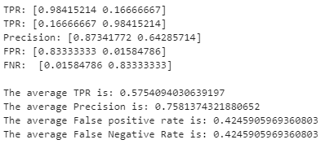
Model Evaluation
Sensitivity (True Positive Rate) = Proportion of those who belong to the classification of 1, and is correctly classified by the model.
TPR = TP / (TP + FN)
Specificity (True Negative Rate) = Proportion of those who belong to the classification of 0, and is correctly classified by the model.
TNR = TN / (TN + FP)

Slide 21

Model Evaluation
Log Loss shows how close the prediction probability matches the actual value.
The more the predicted probability varies from the true value, the higher the log loss.
It is in our interest to minimize log loss
However, this cannot be done within the dataset at this point. It has to be done as ‘hyperparameter tuning’

Slide 22


Model Evaluation
To improve Log Loss, we iterate through a set of possible inverse regularization strength(C), and check the resultant accuracy.
We choose the C value with the highest corresponding Log Loss
A final model was chosen with C=0.000113
Then, a dummy classifier was made to compare against our model

Slide 23
Conclusion
Model “works”, but not great
Accuracy is similar to dummy model, but log loss is much lower.
Type I and Type II errors are likely

Slide 24
Further exploration
Gather more data (tyre types, weather condition, wind speed, track & ambient temp, budget)
Use a different classification model
Feature engineer more
Normalize, then include data from other seasons
Predict finishing position rather than win status. This should prevent the skewed data.

